Slide 1
Classification of News Article Political Leaning
Nawal Valliani
605.744 – Information Retrieval
Final Project
Notes:
Classification of News Article Political Leaning
605.744 – Information Retrieval Final Project

Slide 2
Goal and Application
Goal: binary classification task - using news article headline and article content, can a reliable and accurate classifier be developed to classify news articles as left or right leaning?
Application scenario: a user only wants to see news content from a preferred political leaning from a variety of sources. An automatic news aggregator can classify and filter articles and present them to the user with the preferred political leaning.
“Dem group mocked from all sides after false claim about fuel prices under Biden”
“Tough politics around oil and gas are preventing Joe Biden from being a climate hero.”
Classification Model
Left
Right
Example article sources:
https://www.cnn.com/2021/12/02/politics/interior-oil-gas-report-biden-climate/index.html
https://www.foxbusiness.com/politics/dccc-blasted-both-sides-tweet-praising-biden-gas-prices
Notes:
The goal of this project was to explore various classification algorithms to determine if, using news article headlines, article content, and associated metrics, a reliable and accurate classifier may be developed to classify news articles as left or right leaning.
A potential application scenario is if a user would like to only see news from a preferred political leaning without explicit regard to the originating publisher. A news aggregator can then retrieve news articles, classify them into the appropriate leanings, and present them to the user in a news feed with the user’s preferred political leaning. While not explored in this project, a classifier with three classes – left, right, and middle may be created instead of a binary classification into left or right leaning only.

Slide 3
Relevant Literature
“Classifying the Political Leaning of News Articles and Users from User Votes”
Zhou, Resnick, Mei (2011)
“A Survey of Text Classification Algorithms”
Aggarwal and Zhai (2012)
“Text Classification Using Machine Learning”
Ikonomakis, Kotsiantis, Tampakas (2005)
Notes:
A fair amount of research has been done on the topic of text classification.
Zhou, Resnick, and Mei studied classification of political leaning, much like what is presented herein, using semi-supervised learning methods such as Random Walk and Local/Global Consistency. In cross-validation, their best algorithm achieved 96.3% accuracy on articles sourced from the social network Digg.
In “A Survey of Text Classification Algorithms,” Aggarwal and Zhai note that decision trees, pattern/rule based classifiers, SVM classifiers, and neural network classifiers are among the most commonly used methods for text classification.
In “Text Classification Using Machine Learning,” Ikonomakis, Kotsiantis, and Tapakas provide a framework for performing classification. This framework consists of the following steps in order: tokenization/normalization, stemming/lemmatization, stop word removal, vectorization of text, feature selection, then process through the learning algorithm. This framework laid out by Ikonomakis et al. is followed herein.

Slide 4
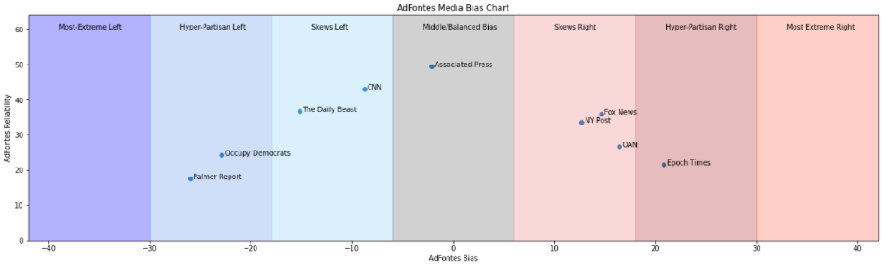
News Article Data
News articles scraped from select publishers across the political spectrum
Political spectrum defined by AdFontes Media
Scraping performed using BeautifulSoup4
1,494 unique news articles acquired
Notes:
The AdFontes Media Bias chart was used as a starting point for this project. Analysts at AdFontes media have scored many different news publishers in terms of bias and reliability. A higher reliability score indicates the publisher is more reliable and content is mostly factual. The opposite is true for lower reliability scores. A negative bias score indicates the publisher is left-leaning, and gets progressively extreme as the number gets more negative. The opposite is true for positive bias scores. The middle region is defined by bias scores spanning roughly +/- 6, and sources in the middle tend to have higher reliability scores.
This bias and reliability spectrum was used to select several publishers from which to acquire news articles from for use in classification. Headlines and news article content were scraped using Python’s BeautifulSoup library over a period of approximately two weeks. 1,494 unique news articles were acquired over this time period.

Slide 5
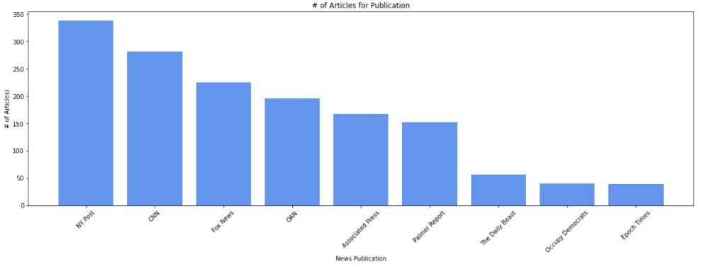
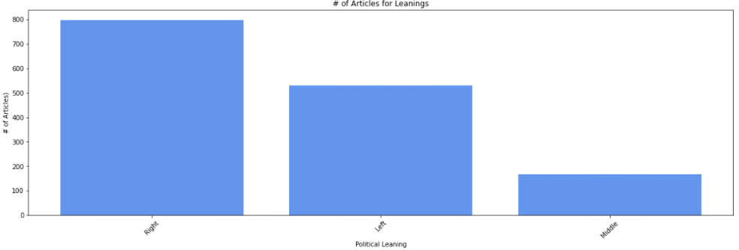
News Article Data
Nine publishers across bias/reliability spectrum
Notes:
The distribution of articles per publisher and articles per political leaning is shown here. Based on the AdFontes Media bias and reliability spectrum, articles from the different publishers were labelled as “Left,” “Right,” or “Middle.” Ideally, each document would be labelled at the document-level; however, no such dataset was readily available. So, publisher-level labels were used.
Note that the “Middle” class was only used during the Exploratory Data Analysis. In the classification process, the “Middle” news articles were classified as either “Left” or “Right” strictly based on the bias scores. Once this was done, the differences in class labels becomes approximately equal.

Slide 6
Understanding the Data: Exploratory Data Analysis
Data Scrubbing
Removal of publisher specific terms (e.g., news articles from CNN have instances of “CNN” removed, and so forth)
Headline/Article Content Length
Topic Modeling
Latent Dirichlect Allocation (LDA)
Non-negative Matrix Factorization (NMF)
Sentiment Analysis – Polarity
Word Clouds
How positive or negative are the headlines/articles?
Frequently used terms
Relationship between leaning and headline/article length
Relationship between headline and article length
Stop word removal, lemmatization, case-folding, punctuation removal
Notes:
Prior to attempting any machine learning models, an in-depth exploratory data analysis was conducted. News articles and headlines were scrubbed of publisher specific terminology, and the relationship between differing political leaning and headline/content length was examined. Topic modeling was done using two popular approaches – LDA and NMF. The polarity of articles was also examined. Word clouds were created to visualize the more frequently used terms, but are not included herein.

Slide 7
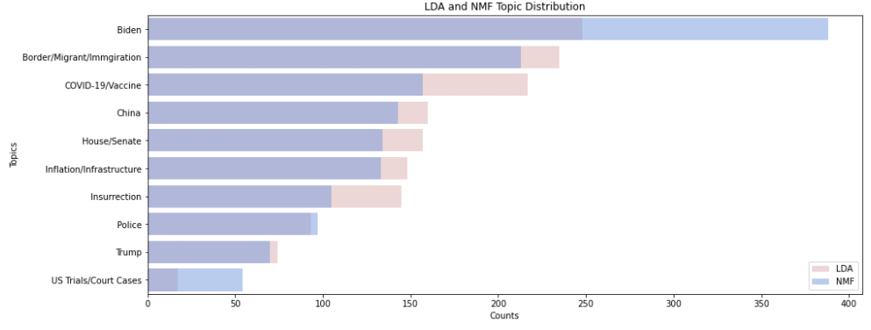
Topic Modeling – LDA and NMF
Notes:
The acquired news articles covered a variety of political topics. With the aid of LDA and NMF, 10 topics were extracted from the article content data. The LDA and NMF output is a bag of interrelated words which were manually assigned topics by myself. There is considerable overlap between the topics outputted from both approaches; however, the number of articles assigned to each topic vary significantly between the two approaches. A significant number of articles discuss the Biden Administration, Border Crises, and the COVID-19 pandemic related vaccines. At the bottom of the list are articles relevant to Trump and current trials/court cases in the US.

Slide 8
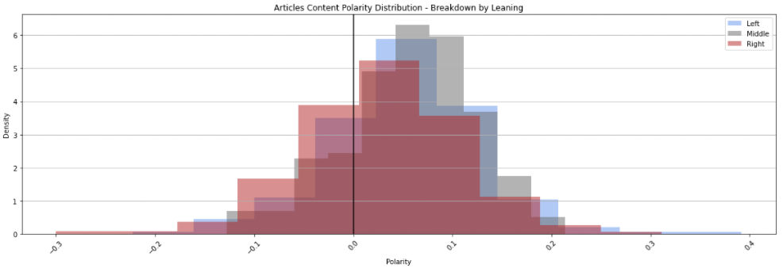
Sentiment Analysis - Polarity
Notes:
The polarity of news articles was analyzed. Polarity spans the range -1.0 to +1.0, with higher positive values indicating presence of positive words and higher negative values indicating presence of negative words. From the histogram, it appears that right-leaning articles have more negative verbiage than left or right leaning articles. On the negative end of the spectrum, there is a higher density of right-leaning articles. On the positive end of the spectrum, the middle and left articles have a higher density. This difference in polarity may prove useful in building a classifier which utilizes the polarity feature.

Slide 9
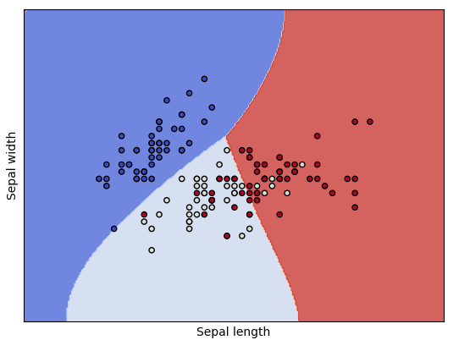
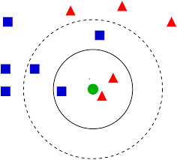
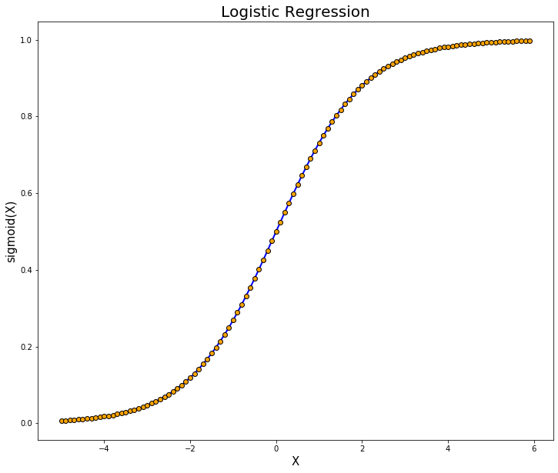
Model Development
Several classification algorithms explored:
K-Nearest Neighbors
Logistic Regression
Support Vector Machine
Various kernels
Decision Tree
Random Forest
Hyperparameter tuning as required
K-Nearest Neighbors
Support Vector Machine
Logistic Regression
Notes:
Several classification algorithms are explored herein: [name them]
Hyperparameter tuning was performed as required. For example, the neighborhood size in kNN and maximum tree depth for decision trees/random forest.

Slide 10
Experimental Design
Headline/article length, topics, and polarity only
1
Headline content only
2
NLTK stop word removal, WordNet lemmatization, normalization
Documents represented as TF-IDF vectors using scikit-learn
Article content only
3
NLTK stop word removal, WordNet lemmatization, normalization
Documents represented as TF-IDF vectors using scikit-learn
5-Fold Cross Validation
Notes:
Three different approaches to creating a classifier were taken. The first approach involved using only the headline length, article length, the assigned topic, and polarity values as training and testing data. The second method utilized headline text only after stop word removal, normalization, lemmatization, TF-IDF vectorization. The third method was similar to the second method, but utilized the article content text only.
5-Fold Cross Validation was used for each model to ensure that all documents were used as training data at some point and to ensure the performance of a model was not due to a favorable (or unfavorable) random test/train split.

Slide 11
Headline/Content Metrics and LDA/NMF Topics
 | NMF | LDA
Model | Precision
K-Nearest Neighbors | 0.5773 | 0.5773
Decision Tree | 0.6745 | 0.7623
Random Forest | 0.7314 | 0.7676
How well can the data be classified without looking explicitly at the headline/article terms?
Compare to Majority Vote Classifier Precision: 0.5338
Notes:
The headline and content length, polarity, and topics were first modeled with a smaller subset of models shown here to gauge the performance of predictions without explicitly looking at the text within headlines and news articles. The baseline model that all machine learning models are compared against is the majority vote classifier, which simply assigns each test data point the dominant class label from the training data. The objective of comparing the machine learning models to this basic classifier is to ensure that predictions from the ML model are actually better than simply picking the majority class for each data point. If the majority vote classifier performs better than ML models, there is no point in creating such a classifier.
All models outperform the majority vote classifier in terms of precision. kNN is marginally better than the majority vote, whereas decision trees and random forest perform much better than kNN. Using the topics generated by LDA, the precision of the decision trees and random forest varies. LDA appears to be the preferred method of topic modeling for this approach of classifying news articles.

Slide 12
Headline Only - Results
Model | Avg. Accuracy | Avg. Precision | Avg. Recall | Avg. F1
Majority Vote | 0.5338 | 0.5338 | 1.0000 | 0.696
K-Nearest Neighbors | 0.9250 | 0.9488 | 0.9120 | 0.9284
Logistic Regression | 0.8882 | 0.8717 | 0.9378 | 0.9002
SVM – RBF | 0.9350 | 0.9246 | 0.9609 | 0.9408
SVM – Linear | 0.9143 | 0.9144 | 0.9301 | 0.9205
SVM – Sigmoid | 0.8748 | 0.8654 | 0.9128 | 0.8861
SVM – Polynomial (3) | 0.8968 | 0.8937 | 0.9335 | 0.9049
SVM – Polynomial (5) | 0.8854 | 0.8771 | 0.9354 | 0.8949
Decision Tree | 0.9357 | 0.9446 | 0.9369 | 0.9395
Random Forest | 0.9404 | 0.9467 | 0.9446 | 0.9443
Notes:
All document’s headlines were vectorized using TF-IDF vectorization and modeled with the larger selection of machine learning models, all of which are compared to the majority vote classifier. In terms of average F1 score from 5-Fold Cross Validation, the random forest model outperforms the other models. In a close second is support vector machine using the radial basis function kernel.

Slide 13
Article Content Only - Results
Model | Avg. Accuracy | Avg. Precision | Avg. Recall | Avg. F1
Majority Vote | 0.5338 | 0.5338 | 1.0000 | 0.6960
K-Nearest Neighbors | 0.9410 | 0.9571 | 0.9332 | 0.9442
Logistic Regression | 0.9290 | 0.9285 | 0.9442 | 0.9344
SVM – RBF | 0.9612 | 0.9613 | 0.9685 | 0.964
SVM – Linear | 0.9672 | 0.9729 | 0.9672 | 0.9694
SVM – Sigmoid | 0.9544 | 0.9638 | 0.9524 | 0.9573
SVM – Polynomial (3) | 0.9256 | 0.9238 | 0.9491 | 0.932
SVM – Polynomial (5) | 0.8962 | 0.8893 | 0.9384 | 0.9049
Decision Tree | 0.9692 | 0.9725 | 0.9700 | 0.9709
Random Forest | 0.9719 | 0.9758 | 0.9735 | 0.9739
Notes:
Next, the article content only was used to create ML models. Looking again at the average F1 score from 5-Fold Cross Validation, the random forest model outperforms the other models. The decision tree model performs close to the random forest across all metrics. For this approach, the support vector machine with a linear kernel slightly outperforms the SVM with RBF kernel, unlike seen with the headline data only.

Slide 14
Conclusions and Takeaways
Reliable and accurate classification models are possible
Aggarwal and Zhai’s claims are confirmed
Framework laid out by Ikonomakis et al. is a good process to follow
Models that do not explicitly account for headline/article content text perform better than anticipated
Can be used for quick classification and presentation of results if the user has a tolerance for incorrectly classified articles
Random Forest classification outperforms all tested models with TF-IDF vectorized documents
Takes longer due to more data, but provides highest quality classifications for the user in the proposed application scenario
Suggestions for future work
Larger corpus
More publishers
Document-level class labels
Larger classification scope (3+ classes)
Notes:
The following conclusions are reached:
Reliable and accurate classification models are feasible.
Quick classification with tolerable results can be achieved by modeling only the headline/article polarity, headline/content length, and predicted topic.
Random forest classification outperforms all tested models when modeling documents as TF-IDF vectors. This takes longer as the process is more involved, but provides higher quality classifications than the previous approach.
For future work, suggestions include:
Forming a larger corpus, perhaps with a larger variety of publishers
Labelling the documents as left or right at the document-level versus the publisher level
Performing a non-binary classification, perhaps with three or more classes.

Slide 15
Thank you for watching! ☺
Nawal Valliani
605.744 – Information Retrieval
Final Project

